Slide 1

Logical Thinking
Section 1.1
Practice

Slide 2
Position of members
Barira, Rabia, Tania, and Ayeshum were recently elected as the new class officers (president, vice president, secretary, treasurer) . From the following clues, determine which position each holds.
1. Ayeshum is younger than the president but older than the treasurer.
2. Barira and the secretary are both the same age, and they are the youngest members of the group.
3. Tania and the secretary are next door neighbors.
 | Barira | Rabia | tania | ayeshum
President | X | x | president | x
V president | X | x | X | tick
secretary | X | tick | X | X
Treasurer | tick | x | X | x

Slide 3
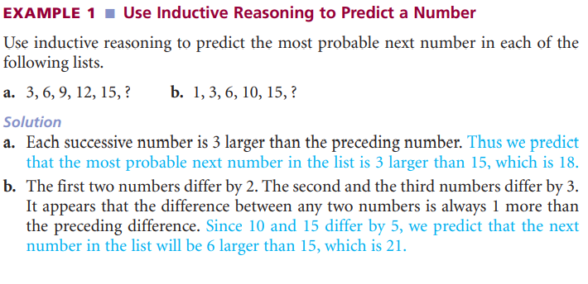
Sample Question

Slide 4
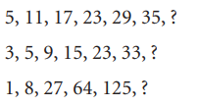
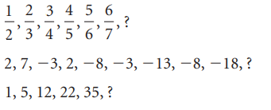
use inductive reasoning to predict the most probable next number in each list.

Slide 5
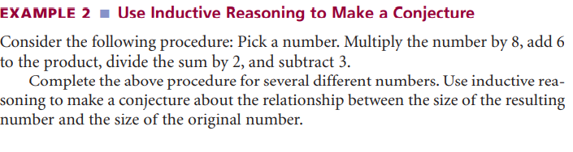
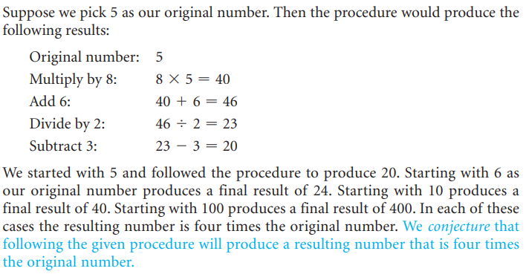
Sample Question

Slide 6
use inductive reasoning to decide whether the conclusion for each argument is correct.
Note: The numbers 1, 2, 3, 4, ... are called natural numbers or counting numbers. The numbers …, –3, -2, -1, 0, 1, 2, 3, ... are called integers.
The sum of any two even numbers is an even number.
N+ N = 2N
The product of an odd integer and an even integer is always an even number.

Slide 7
use deductive reasoning to decide whether the conclusion for each argument is correct.
Pick any counting number. Multiply the number by 8. Subtract 4 from the product. Divide the difference by 4. Add 1 to the quotient. The resulting number is twice the original number.
Multiply the number by 12: 12N
Subtract 18 from the product 12N – 18
Divide the difference by 6 (12N-18) /6 ==> 2N-3
Add 3 to the quotient. 2N-3 +3
Answer : N ===> 2N

Slide 8
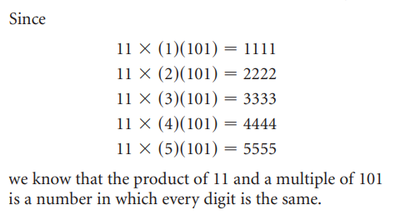
determine whether the argument is an example of inductive reasoning or deductive reasoning.
Every English setter likes to hunt. Duke is an English setter, so Duke likes to hunt.
Cats don’t eat tomatoes. Scat is a cat. Therefore, Scat does not eat tomatoes.

Slide 9
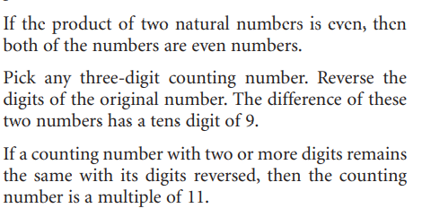
find a counterexample to show that the statement is false.

